Slide 1
Chapter Twelve
Cost Minimization
成本最小化

Slide 2
Structure
The cost minimization problem
Average costs
Returns to scale and total and average costs
Short run and long run costs

Slide 3
Cost Minimization
A firm is a cost-minimizer if it produces any given output level y ≥ 0 at smallest possible total cost.
c(y) denotes the firm’s smallest possible total cost for producing y units of output.
c(y) is the firm’s total cost function （总成本函数）.

Slide 4
Cost Minimization
When the firm faces given input prices w = (w₁,w₂,…,w_{n}) the total cost function will be written as
c(w₁,…,w_{n},y).

Slide 5
The Cost-Minimization Problem
Consider a firm using two inputs to make one output.
The production function is
y = f(x₁,x₂).
Take the output level y ≥ 0 as given.
Given the input prices w₁ and w₂, the cost of an input bundle (x₁,x₂) is w₁x₁ + w₂x₂.

Slide 6
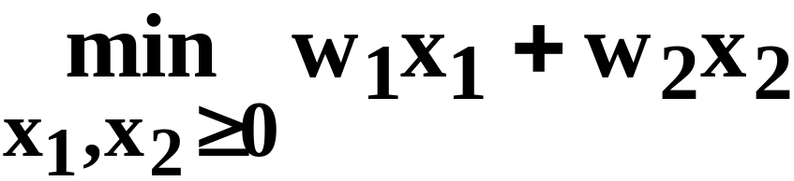
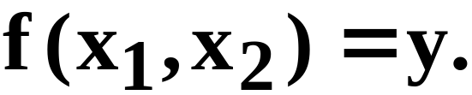
The Cost-Minimization Problem
For given w₁, w₂ and y, the firm’s cost-minimization problem is to solve
subject to

Slide 7
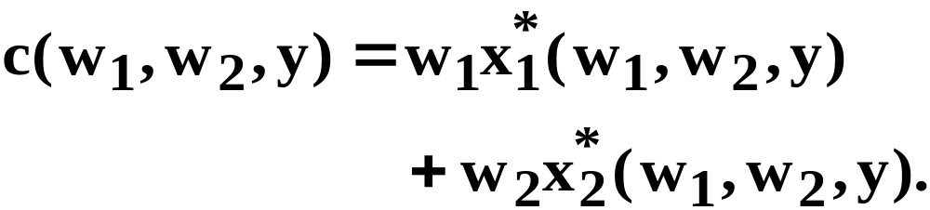
The Cost-Minimization Problem
The levels x₁*(w₁,w₂,y) and x₁*(w₁,w₂,y) in the least-costly input bundle are the firm’s conditional demands for inputs 1 and 2 （条件要素需求）.
The (smallest possible) total cost for producing y output units is therefore

Slide 8
Conditional Input Demands
Given w₁, w₂ and y, how is the least costly input bundle located?
And how is the total cost function （成本函数）computed?

Slide 9
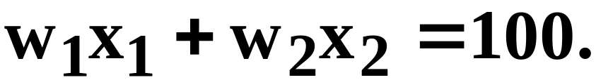
Iso-cost Lines （等成本线）
A curve that contains all of the input bundles that cost the same amount is an iso-cost curve.
E.g., given w₁ and w₂, the $100 iso-cost line has the equation

Slide 10
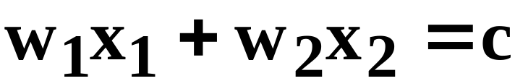
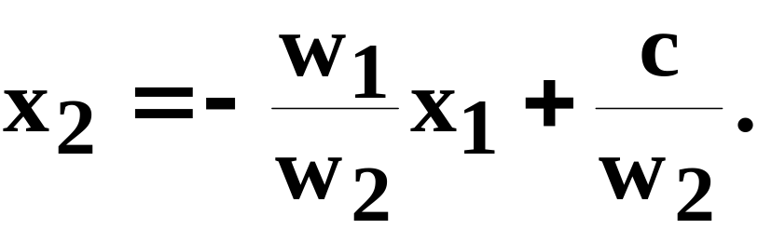
Iso-cost Lines
Generally, given w₁ and w₂, the equation of the iso-cost line is
i.e.
Slope is - w₁/w₂.

Slide 11
Iso-cost Lines
x₂
Slopes = -w₁/w₂.
c” ≡ w₁x₁+w₂x₂
c’ ≡ w₁x₁+w₂x₂
c’ < c”
x₁

Slide 12
The y’-Output Unit Isoquant
x₂
All input bundles yielding y’ units
of output. Which is the cheapest?
f(x₁,x₂) ≡ y’
x₁

Slide 13
The Cost-Minimization Problem
x₂
All input bundles yielding y’ units
of output. Which is the cheapest?
f(x₁,x₂) ≡ y’
x₁

Slide 14
The Cost-Minimization Problem
x₂
All input bundles yielding y’ units
of output. Which is the cheapest?
x₂*
f(x₁,x₂) ≡ y’
x₁*
x₁

Slide 15
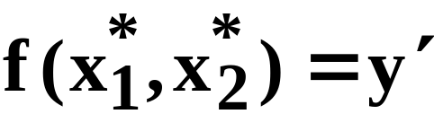
The Cost-Minimization Problem
At an interior cost-min input bundle:
(a)
x₂
x₂*
f(x₁,x₂) ≡ y’
x₁*
x₁

Slide 16
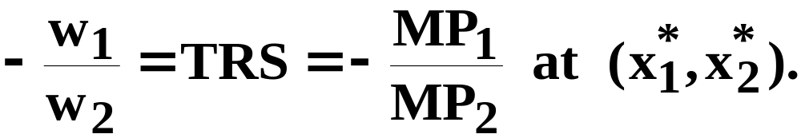
The Cost-Minimization Problem
At an interior cost-min input bundle:
(a) and
(b) slope of isocost = slope of
isoquant; i.e.
x₂
x₂*
f(x₁,x₂) ≡ y’
x₁*
x₁

Slide 17
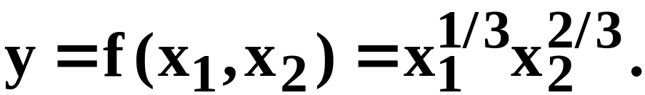
A Cobb-Douglas Example of Cost Minimization
A firm’s Cobb-Douglas production function is
Input prices are w₁ and w₂.
What are the firm’s conditional input demand functions?

Slide 18
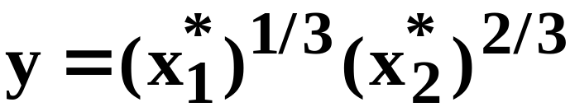
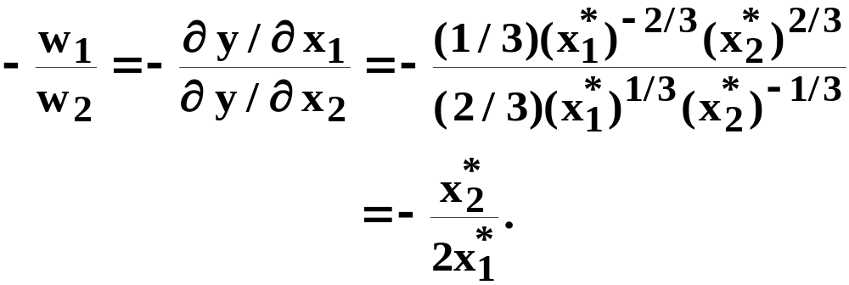
A Cobb-Douglas Example of Cost Minimization
At the input bundle (x₁*,x₂*) which minimizes
the cost of producing y output units:
(a)
(b)
and

Slide 19
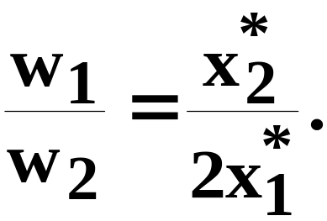
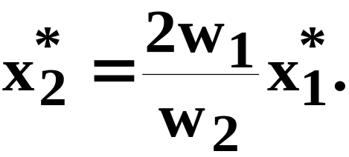
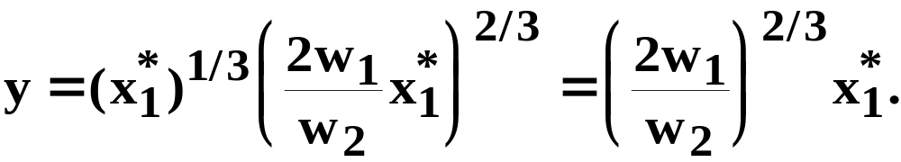
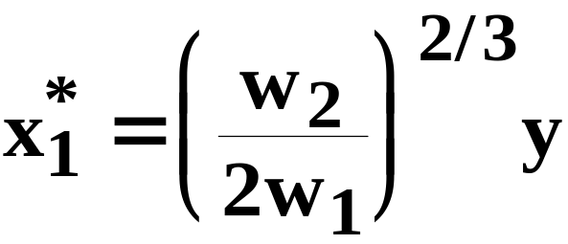
A Cobb-Douglas Example of Cost Minimization
(a)
(b)
From (b),
Now substitute into (a) to get
So
is the firm’s conditional
demand for input 1.

Slide 20
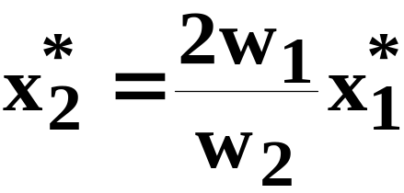
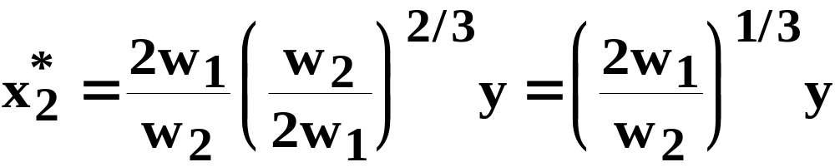
A Cobb-Douglas Example of Cost Minimization
Since
and
is the firm’s conditional demand for input 2.

Slide 21
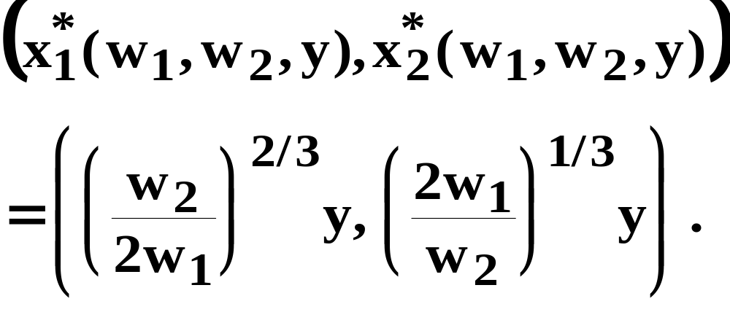
A Cobb-Douglas Example of Cost Minimization
So the cheapest input bundle yielding y
output units is

Slide 22
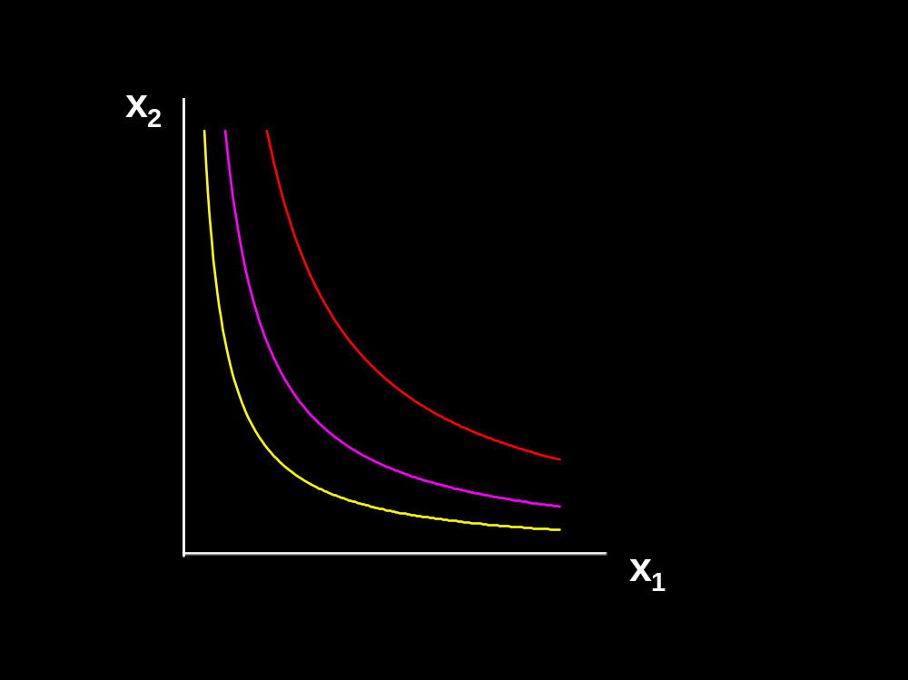



Conditional Input Demand Curves
Fixed w₁ and w₂.

Slide 23
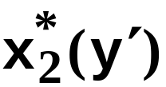

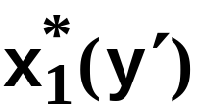


Conditional Input Demand Curves
Fixed w₁ and w₂.

Slide 24
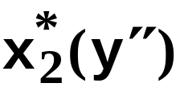
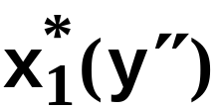

Conditional Input Demand Curves
Fixed w₁ and w₂.

Slide 25

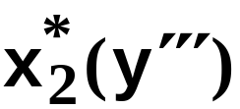
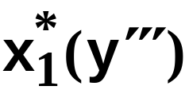

Conditional Input Demand Curves
Fixed w₁ and w₂.

Slide 26
Conditional Input Demand Curves
Cond. demand
for
input 2
Fixed w₁ and w₂.
output
expansion
path
Cond.
demand
for
input 1

Slide 27
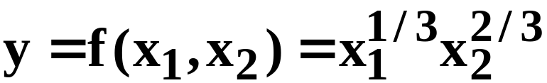
A Cobb-Douglas Example of Cost Minimization
For the production function
the cheapest input bundle yielding y output
units is

Slide 28
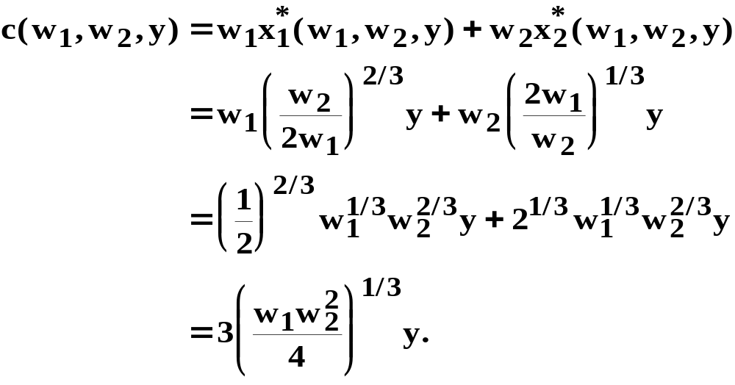
A Cobb-Douglas Example of Cost Minimization
So the firm’s total cost function is

Slide 29
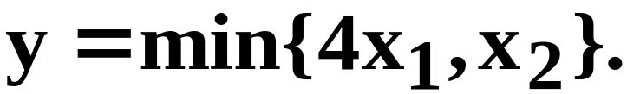
A Perfect Complements Example of Cost Minimization
The firm’s production function is
Input prices w₁ and w₂ are given.
What are the firm’s conditional demands for inputs 1 and 2?
What is the firm’s total cost function?

Slide 30
A Perfect Complements Example of Cost Minimization
x₂
Where is the least costly
input bundle yielding
y’ output units?
4x₁ = x₂
x₂* = y
min{4x₁,x₂} ≡ y’
x₁*
= y/4
x₁

Slide 31
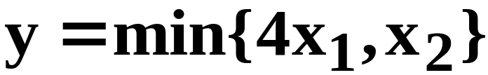
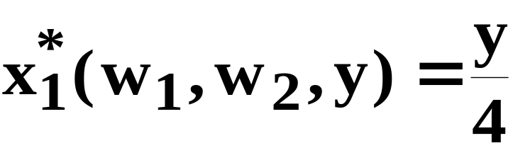
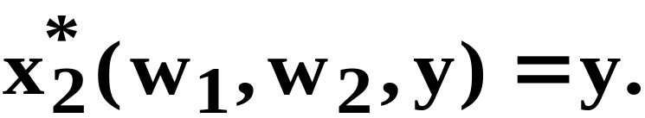
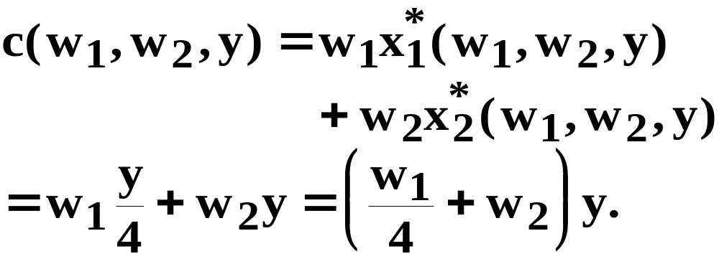
A Perfect Complements Example of Cost Minimization
The firm’s production function is
and the conditional input demands are
and
So the firm’s total cost function is

Slide 32
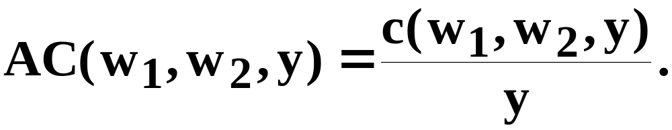
Average Total Production Costs
For positive output levels y, a firm’s average total cost of producing y units is

Slide 33
Returns-to-Scale and Av. Total Costs
The returns-to-scale properties of a firm’s technology determine how average production costs change with output level.
Our firm is presently producing y’ output units.
How does the firm’s average production cost change if it instead produces 2y’ units of output?

Slide 34
Constant Returns-to-Scale and Average Total Costs
If a firm’s technology exhibits constant returns-to-scale then doubling its output level from y’ to 2y’ requires doubling all input levels.
Total production cost doubles.
Average production cost does not change.

Slide 35
Decreasing Returns-to-Scale and Average Total Costs
If a firm’s technology exhibits decreasing returns-to-scale then doubling its output level from y’ to 2y’ requires more than doubling all input levels.
Total production cost more than doubles.
Average production cost increases.

Slide 36
Increasing Returns-to-Scale and Average Total Costs
If a firm’s technology exhibits increasing returns-to-scale then doubling its output level from y’ to 2y’ requires less than doubling all input levels.
Total production cost less than doubles.
Average production cost decreases.

Slide 37
Returns-to-Scale and Av. Total Costs
$/output unit
AC(y)
decreasing r.t.s.
constant r.t.s.
increasing r.t.s.
y

Slide 38
Returns-to-Scale and Total Costs
What does this imply for the shapes of total cost functions?

Slide 39
Returns-to-Scale and Total Costs
Av. cost increases with y if the firm’s
technology exhibits decreasing r.t.s.
$
c(y)
c(2y’)
Slope = c(2y’)/2y’
= AC(2y’).
Slope = c(y’)/y’
= AC(y’).
c(y’)
y’
2y’
y

Slide 40
Returns-to-Scale and Total Costs
Av. cost decreases with y if the firm’s
technology exhibits increasing r.t.s.
$
c(y)
c(2y’)
Slope = c(2y’)/2y’
= AC(2y’).
c(y’)
Slope = c(y’)/y’
= AC(y’).
y’
2y’
y

Slide 41
Returns-to-Scale and Total Costs
Av. cost is constant when the firm’s
technology exhibits constant r.t.s.
$
c(2y’)
=2c(y’)
c(y)
Slope = c(2y’)/2y’
= 2c(y’)/2y’
= c(y’)/y’
so
AC(y’) = AC(2y’).
c(y’)
y’
2y’
y

Slide 42
Short-Run & Long-Run Total Costs
In the long-run a firm can vary all of its input levels.
Consider a firm that cannot change its input 2 level from x₂’ units.
How does the short-run total cost of producing y output units compare to the long-run total cost of producing y units of output?

Slide 43
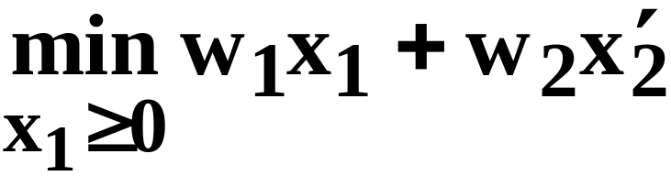
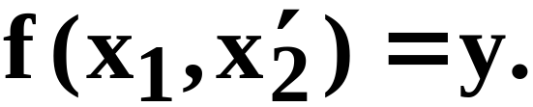
Short-Run & Long-Run Total Costs
The long-run cost-minimization problem is
The short-run cost-minimization problem is
subject to
subject to

Slide 44
Short-Run & Long-Run Total Costs
The short-run cost-min. problem is the long-run problem subject to the extra constraint that x₂ = x₂’.
If the long-run choice for x₂ was x₂’ then the extra constraint x₂ = x₂’ is not really a constraint at all and so the long-run and short-run total costs of producing y output units are the same.

Slide 45
Short-Run & Long-Run Total Costs
But, if the long-run choice for x₂ ≠ x₂” then the extra constraint x₂ = x₂” prevents the firm in this short-run from achieving its long-run production cost, causing the short-run total cost to exceed the long-run total cost of producing y output units.

Slide 46



Short-Run & Long-Run Total Costs
Consider three output levels.
x₂
x₁

Slide 47
Short-Run & Long-Run Total Costs
In the long-run when the firm
is free to choose both x₁ and
x₂, the least-costly input
bundles are ...
x₂
x₁

Slide 48






Short-Run & Long-Run Total Costs
x₂
Long-run
output
expansion
path
x₁

Slide 49
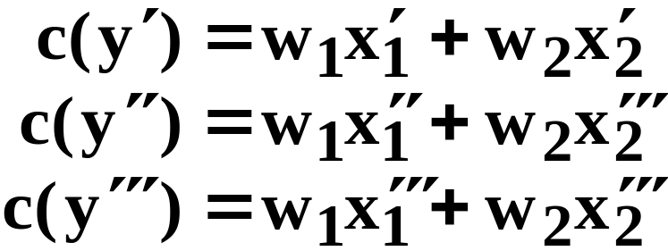
Short-Run & Long-Run Total Costs
Long-run costs are:
x₂
Long-run
output
expansion
path
x₁

Slide 50
Short-Run & Long-Run Total Costs
Now suppose the firm becomes subject to the short-run constraint that x₁ = x₁”.

Slide 51
Short-Run & Long-Run Total Costs
Long-run costs are:
Short-run
output
expansion
path
x₂
x₁

Slide 52

Short-Run & Long-Run Total Costs
Long-run costs are:
Short-run
output
expansion
path
x₂
Short-run costs are:
x₁

Slide 53
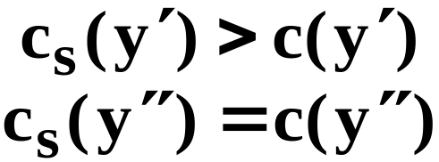
Short-Run & Long-Run Total Costs
Long-run costs are:
Short-run
output
expansion
path
x₂
Short-run costs are:
x₁

Slide 54
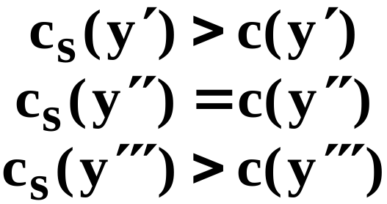
Short-Run & Long-Run Total Costs
Long-run costs are:
Short-run
output
expansion
path
x₂
Short-run costs are:
x₁

Slide 55
Short-Run & Long-Run Total Costs
Short-run total cost exceeds long-run total cost except for the output level where the short-run input level restriction is the long-run input level choice.
This says that the long-run total cost curve always has one point in common with any particular short-run total cost curve.

Slide 56
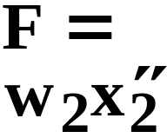
Short-Run & Long-Run Total Costs
A short-run total cost curve always has
one point in common with the long-run
total cost curve, and is elsewhere higher
than the long-run total cost curve.
$
c_{s}(y)
c(y)
y

